Slide 1
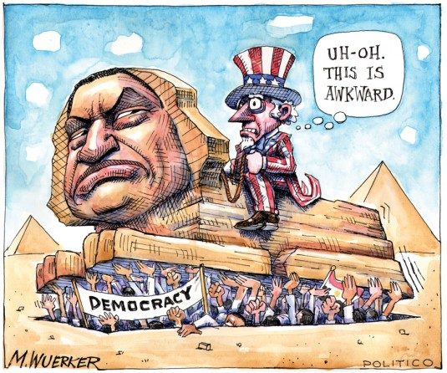
Those Damned Pictures Political cartoons for U.S. Government and History
David Wolfford
Author, AMSCO’s AP US Government and Politics
Teacher, Mariemont High School
Cincinnati, Ohio

Slide 2
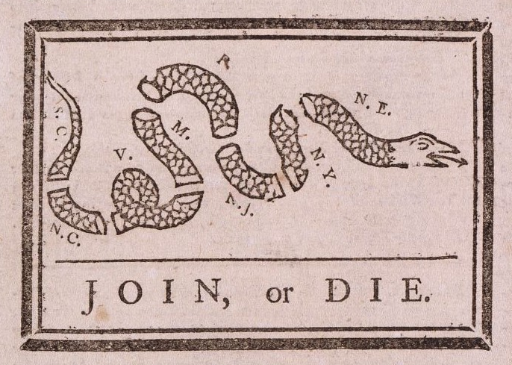
“Join or Die,” Pennsylvania Gazette, 754, (Artist Unknown)

Slide 3
Join or die, 1754
Appeared in Ben Franklin’s Pennsylvania Gazette
Nearing the French & Indian War, the cartoon was meant to unite colonies to act as one entity, though still under British rule.
Artwork often attributed to Franklin, whose editorial accompanied the image, but the identity of the artist isn’t known.
Though colonies didn’t unify at the time, the image served as an almost-logo of the movement toward colonial unity and independence.
History.Com

Slide 4
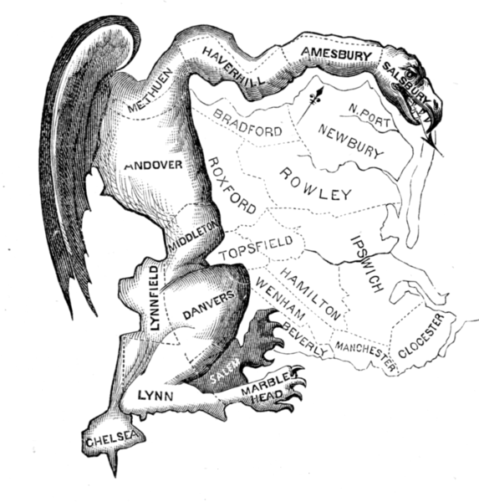
Elkanah Tisdale, “The Gerrymander,” 1812

Slide 5
THe gerrymander, Elkanah Tisdale, 1812
Published after the passage of a Massachusetts law that reformed congressional districts to the Republican’s favor.
Governor Elbridge Gerry signed the bill into law.
Artist Tisdale added a head and wings to an oddly shaped district and labeled it “The Gerry-Mander.”
The actual district was not as mis-shaped as the drawing suggests. Cartoon proved politically effective.
Often mis-attributed to early American artist Gilbert Stuart.
Massachusetts Historical Society

Slide 6
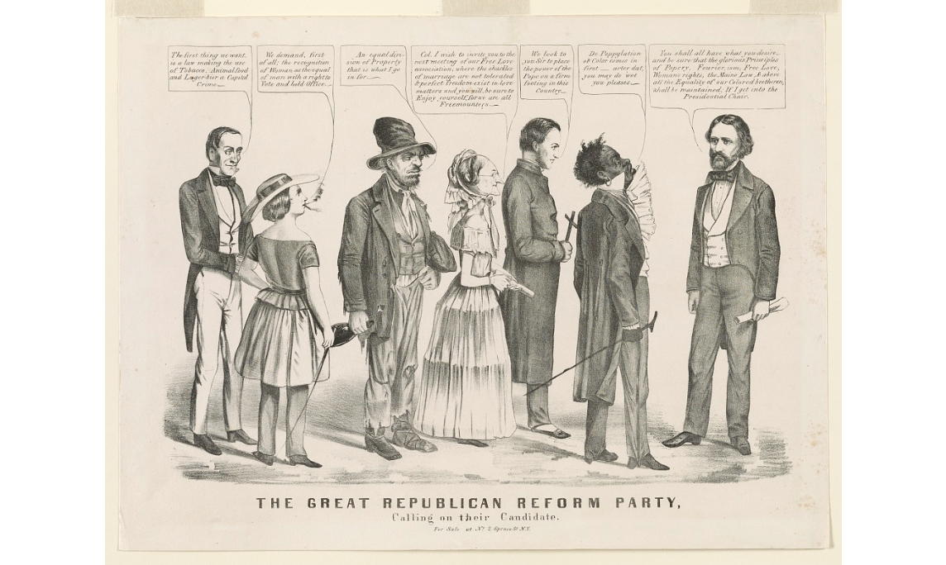
Louis Mauer, “Great American Reform Party,” 1856

Slide 7
Great American reform party, Louis Mauer, 1856
Antebellum cartoons often depicted people in scenes with lengthy dialogue in speech bubbles.
This one a mockery of the new Free Soil (modern Republican) political party.
Reveals the different radical factions in the Republican Party’s tent.
John C. Fremont, Trailblazer, Military Veteran, and Senator is the presidential nominee to the far right.
The “Maine Law” in the cartoon addresses and criticizes prohibition of alcohol.
Library of Congress

Slide 8
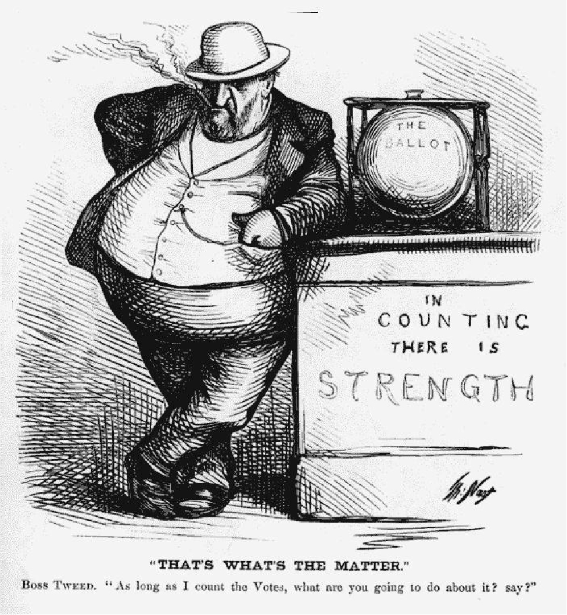
Thomas Nast, “That’s What’s the Matter,” Harper’s Weekly, 1871

Slide 9
That’s What’s the Matter, Thomas Nast, 1871
New York City politico William Marcy Tweed standing aside a ballot box.
Artist Thomas Nast cartooned for Harper’s Weekly and the New York Times.
Boss Tweed and his ring of corrupt officials were Nast’s most common target.
Nast exposed Tweed who was ultimately prosecuted and sent to prison.
Nast is considered the father of modern American political cartooning.
Harper’s Weekly

Slide 10
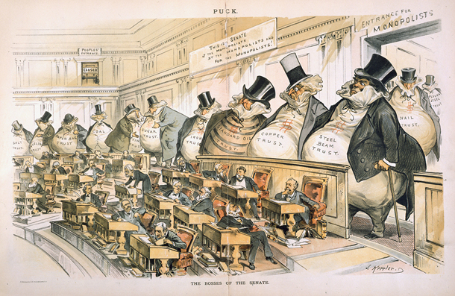
Joseph Keppler, “The Bosses of the Senate,” Puck 1889

Slide 11
THe bosses of the senate, Joseph Keppler, 1889
Joseph Keppler followed Thomas Nast as the nation’s premiere cartoonist.
The U.S. Senate had become a chamber of corruption, as members became more beholden to the monopolies (trusts) of the era than the people from their states.
Keppler’s cartoons appeared in vivid color in Puck Magazine.
This cartoon and others in Puck led to the ratification of the 17th Amendment.
New York Magazine

Slide 12
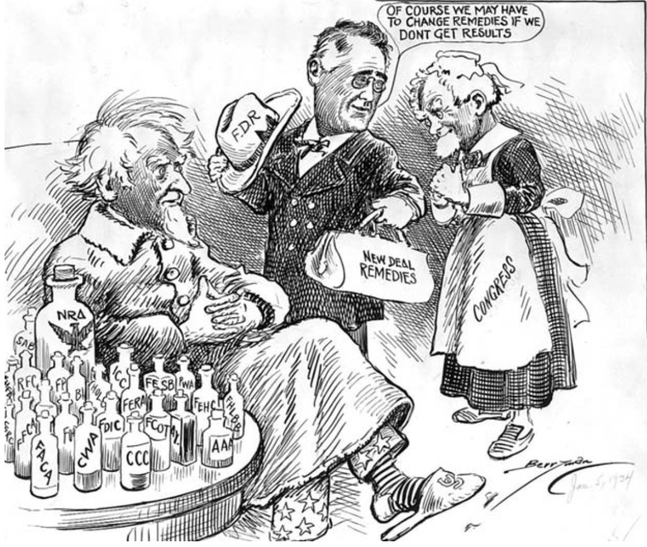
Clifford Berryman, “New Deal Remedies,” Washington Star, 1934

Slide 13
New Deal Remedies, Clifford berryman, 1934
President Franklin Roosevelt is depicted as the doctor making a house call to heal Uncle Sam (the USA).
Medicine bottles represent the many government agencies he and the Congress had already created.
Clifford Berryman moved to Washington to work professionally at age 17.
He drew for the Washington Star for most of his career. Died 1949.
National Archives

Slide 14
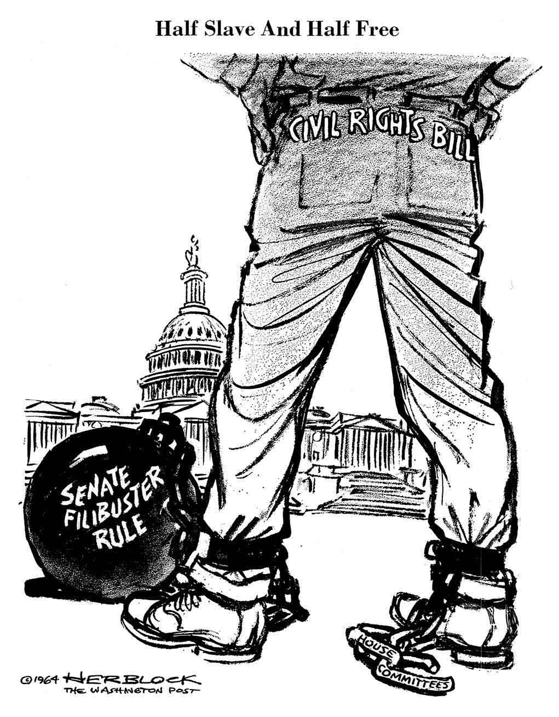
Herb Block, “Half Slave, Half Free,” Washington Post, 1889

Slide 15
Half Slave, Half Free, Herb Block, 1964
Herb Block, aka “Herblock,” cartooned at Washington Post 1946—2001.
Here he depicts the 1964 Civil Rights bill as a slave or chained prisoner in limbo.
The bill had passed the House, not the Senate.
He predicted a filibuster is inevitable, which followed over the following months before bill passed in summer 1964.
Herb Block Gallery, LOC

Slide 16
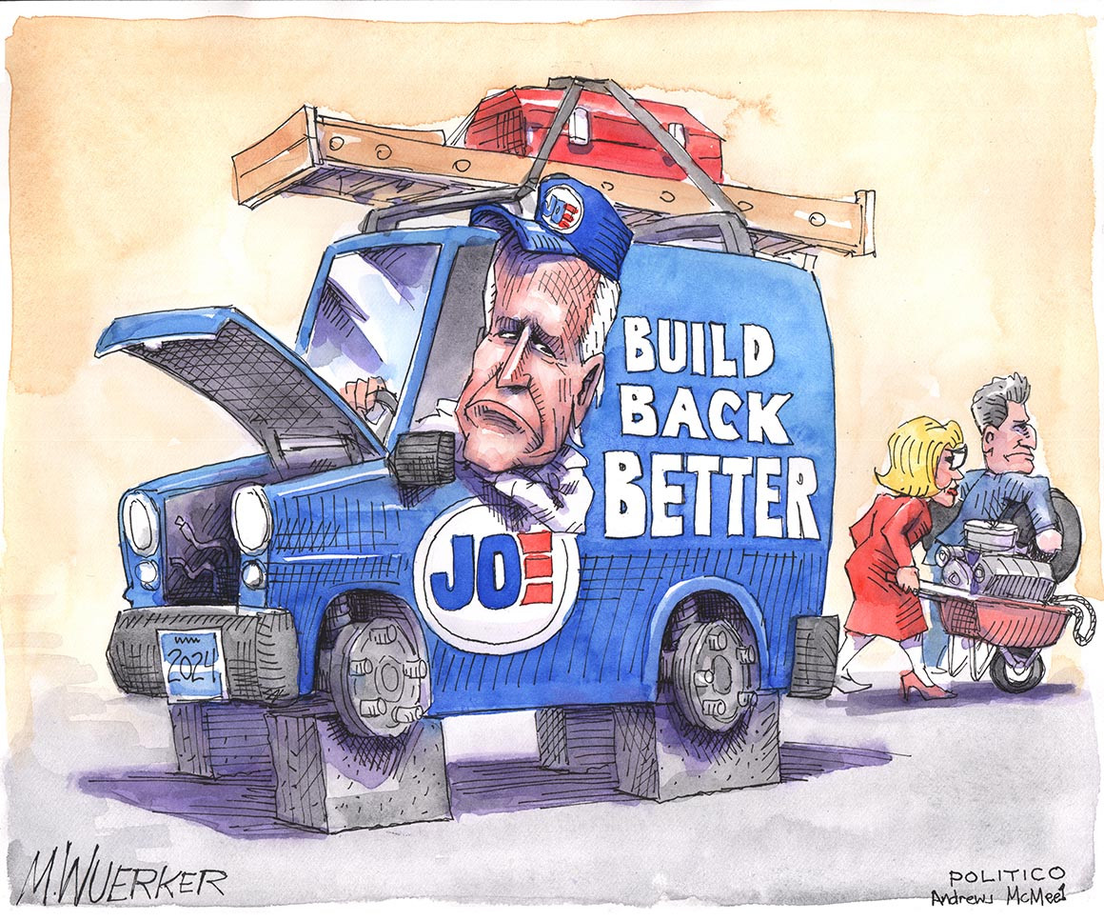
Matt Wueker, Pollitico.com, 2022 (No Title)

Slide 17
Up on Blocks, Matt Wueker, 2022
Wuerker has worked at Politico.Com since it’s founding in 2007. Ink and Watercolor.
President Joe Biden in an inoperable delivery truck stripped by Democrat Senators Kyrsten Sinema and Joe Manchin.
Biden cannot fully deliver his Build Back Better program, and 2024 prospects (front plates) are not good.
Sinema and Manchin are two Senate Democrats unwilling to altering Senate cloture rules to pass Democratic legislation.
CBS Profile of Wuerker Wuerker’s Recents at Politico.Com

Slide 18
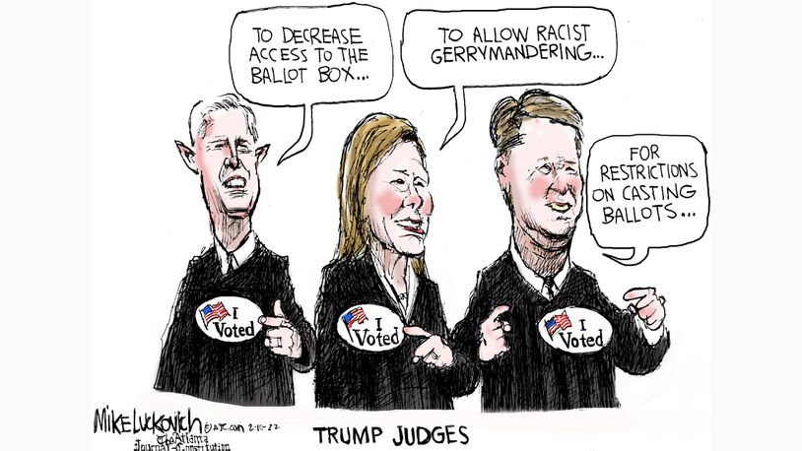
Mike Luckovich, “We Voted,” Atlanta Journal-Constitution, 2022

Slide 19
We Voted, Mike Luckovich, 2022
A depiction of Supreme Court Justices Neil Gorsuch, Amy Coney Barrett, and Brett Kavanaugh amid voting rights case, by of the Atlanta Journal-Constitution.
In an ironic twist, Luckovich suggests justices have disfranchised voters, yet they proudly wear the sticker meant to represent pride in a public election.
Luckovich attended University of Washington and has won the Pulitzer Prize.
His depictions of former President Trump ridicule his hands and expressions.
Atlanta Journal Constitution Between the Lines (YouTube, 7:41)

Slide 20
Tips and Tricks
Cheat with Labels
2-D Drawings can be effective, Drawing Humans Optional
Search News Articles for Dialogue and Quotes
Allusion, Allegory, and Parody are common in Political Cartoons
Brainstorm common symbols

