Slide 1
United States Government and Politics: The Redesigned FRQs
David Wolfford
Mariemont High School

Slide 2


Slide 3
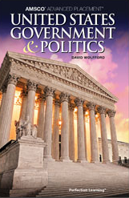
Perfection Sales Rep:
Ronni Scott
rscott@perfectionlearning.com
866-252-6580 ext. 1150

Slide 4
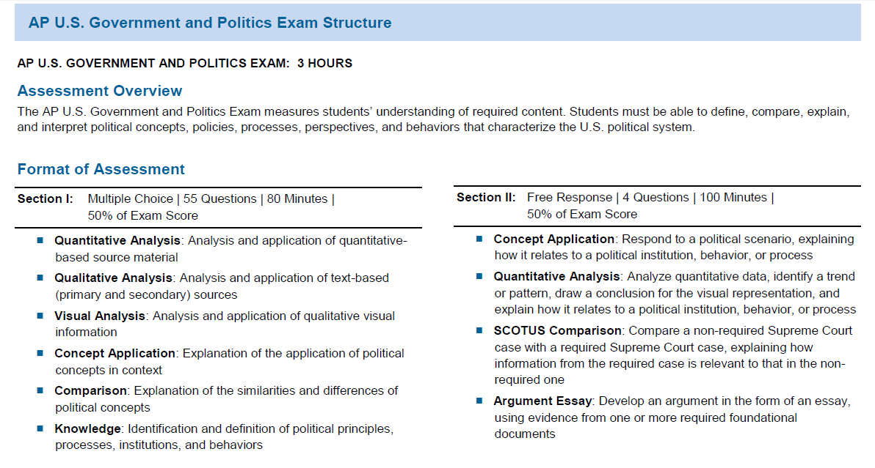

Slide 5

The FRQ Styles
Concept Analysis
Quantitative Analysis
SCOTUS Comparison
Argument Essay

Slide 6
FRQ #1: Concept Application
Respond to a political scenario, explaining how it relates to a political institution, behavior, or process
A Quote from news source or authentic source material
A Text Passage followed by:
(A)
(B)
(C)
Maybe (D)

Slide 7
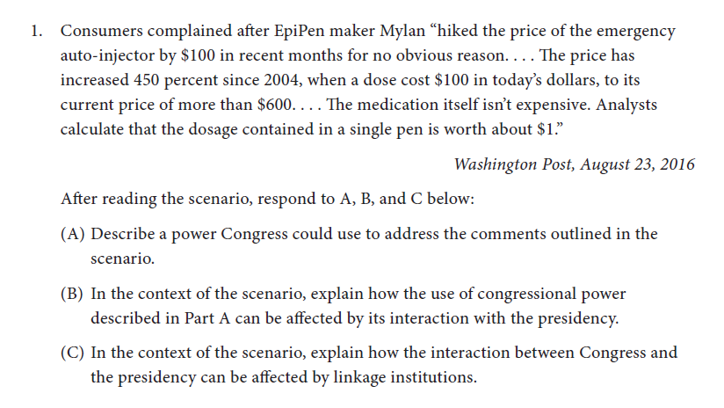

Slide 8
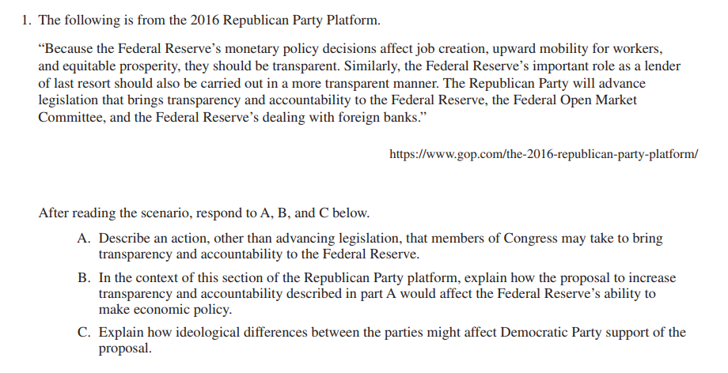

Slide 9
FRQ #2: Quantitative Analysis
Analyze quantitative data, identify a trend or pattern, draw a conclusion for the visual representation, and explain how it relates to a political institution, behavior, or process
A statistical table, chart, or graph followed by:
(A)
(B)
(C)

Slide 10
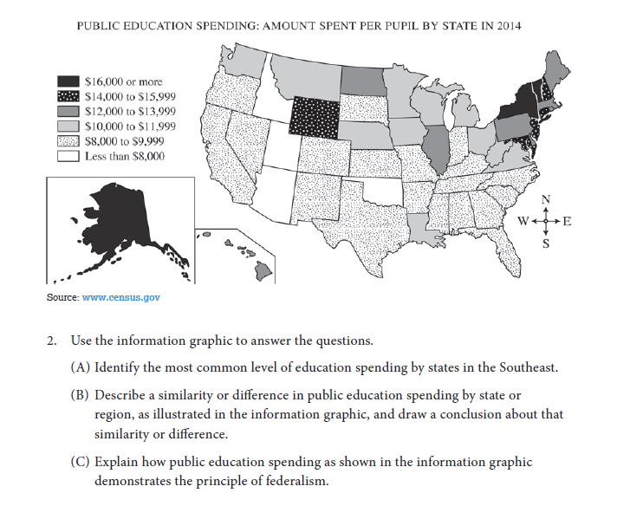

Slide 11
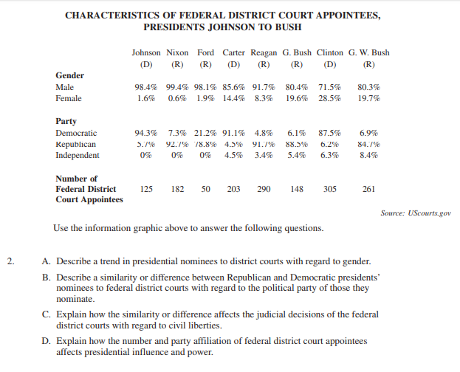

Slide 12
Brainstorm/Draft 2 FRQs individually (3-5 min.), then Pairs/Groups of 3 Discuss/Draft/Polish both FRQs. Consider/Create list of Acceptable Answers for (A), (B), (C), etc. Polish and Place Final Draft of 2 FRQs and possible answers on Yellow Sheet.

Slide 13
FRQ #3: SCOTUS Comparison
Compare a non-required Supreme Court case with a required Supreme Court case, explaining how information from the required case is relevant to that in the non-required one
About a paragraph on the facts and issue in the case, followed by about another paragraph on the ruling

Slide 14
FRQ #4: Argumentative Essay
• Articulate a defensible claim or thesis that responds to the question and establishes a line of reasoning
• Uses two pieces of specific and relevant evidence to support the claim or thesis
• Explain how or why the evidence supports the claim or thesis
• Responds to an opposing or alternate perspective using refutation, concession, or rebuttal

Slide 15

Discussion?
Thanks.
Look for these FRQs in your Inbox.

Slide 16
Perfection Sales Rep:
Ronni Scott
rscott@perfectionlearning.com
866-252-6580 ext. 1150

